Slide 1
Fuzzy Set

Slide 2
Agenda
Fuzzy Set Theory
Fuzzy Set Operations
Properties of Fuzzy Sets

Slide 3
Fuzzy Set
Word “Fuzzy” means vagueness or ambiguity or Uncertainty.
Linguistic variables
Given by Lotfi A Zadeh in 1965 as extension of classical notation set.
In classical set theory membership of the elements in the set in binary terms {0,1}
In fuzzy set theory membership function value is in interval [0,1].

Slide 4
Need of Fuzzy Sets
In real world there exist much fuzzy knowledge(i.e vague, uncertain, inexact etc)
Human thinking and reasoning (analysis, logic, interpretation) frequently involve Fuzzy Information.
Systems were unable to answer many questions because based on classical set theory.
System should be able to cope with unreliable and incomplete information.
Solution USE FUZZY SYSTEMS

Slide 5
Examples
Words like young, tall, good, high are fuzzy.
No single quantitative value which defines these linguistic variable.
Linguistic Variable: Variables with a value made up of linguistic concepts rather than numbers
e.g AGE as a linguistic variable can be defined as
AGE={Child, Young, Old}
Membership value of these variable depends on the context in which it is being considered.

Slide 6
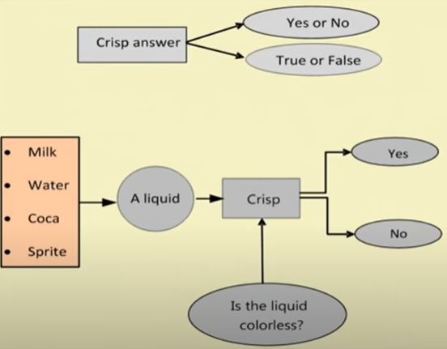
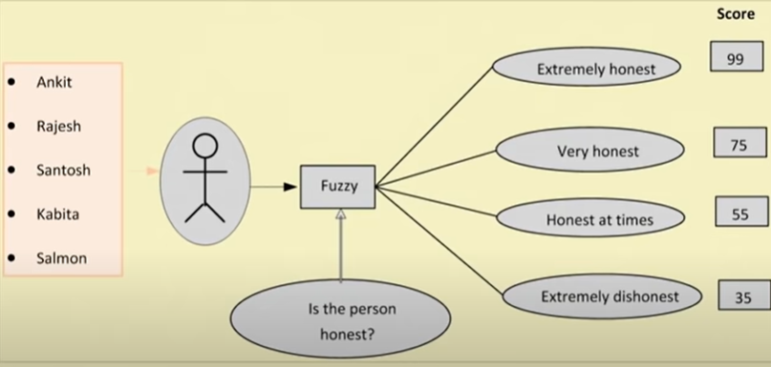
Fuzzy Logic Vs Crisp Logic
Crisp Logic
Fuzzy Logic

Slide 7
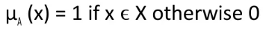
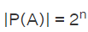
Classical Set Theory
A set is a well defined collection of objects.
An object in a set is called an element or member of that set.
If the element a(i=1,2,3…..n) of a set A are subset of universal set Then set A can be represented for all elements x X by its characteristics function
Cardinality of a Set: Number of elements in the set
Power Set(P(A)): Family set containing subset of A.
Cardinality of Power Set:

Slide 8
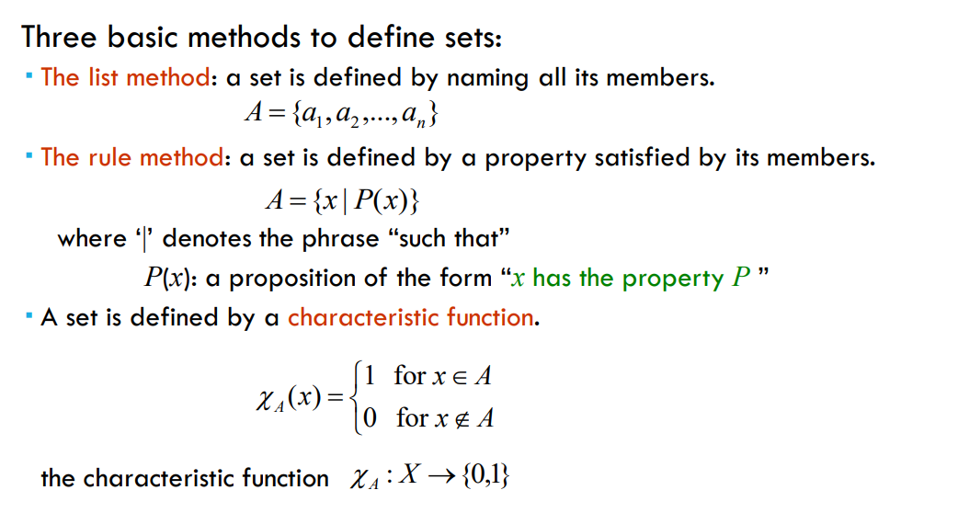
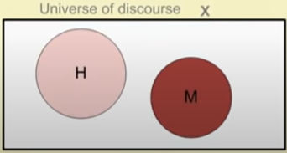
CRISP SET
Example
x= All students of class
H= students having equal to or more than 80% marks
M= students having less than 80% marks
Here all are set of finite number of individual. Such a set is called crisp set

Slide 9
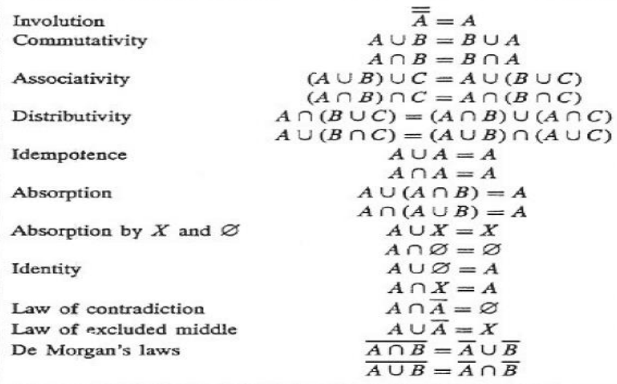
Features of CRISP Set

Slide 10
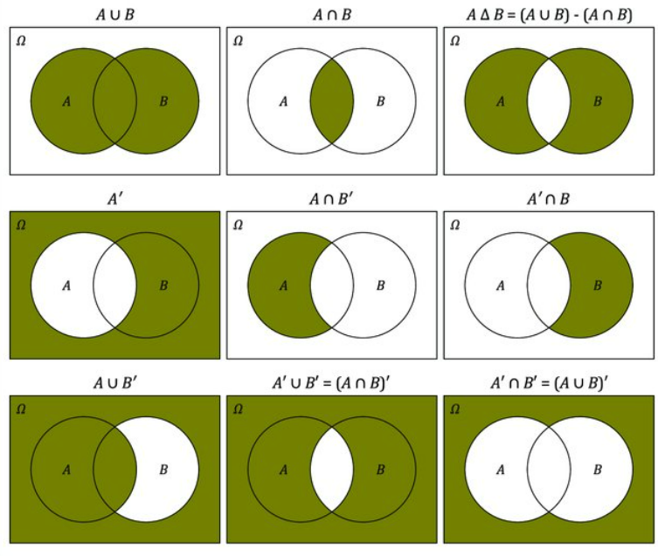

Slide 11

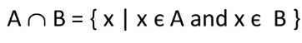
Operations on Classical Sets
Union: Union of two sets A and B is given as
Intersection: Intersection of two sets A and B is given as
Complement: Complement of a set is denoted by

Slide 12
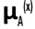
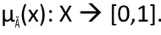
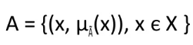
Fuzzy Set Theory
Extension of classical set theory
A logic based on two truth value True and False is sometime insufficient when describing human reasoning.
Fuzzy Logic uses whole interval between 0(false) and 1(true) to describe human reasoning i.e allows members to have different degree of membership called membership function having interval [0,1]
Thus a membership function is associated with a fuzzy set A such that the function maps every element of universe of discourse X to interval [0,1]
Mapping is written as
Fuzzy Set: If X is an universe of discourse and x is a particular element of X,then a fuzzy set A defined on X can be written as a collection of ordered pair

Slide 13
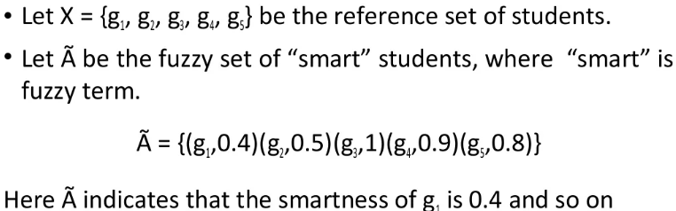
Fuzzy Set Example
Other examples are
High Temperature
Low pressure
Colour of Apple
Sweetness of Orange
Weight of mango
Note: Degree of membership lie in range [1….0]

Slide 14
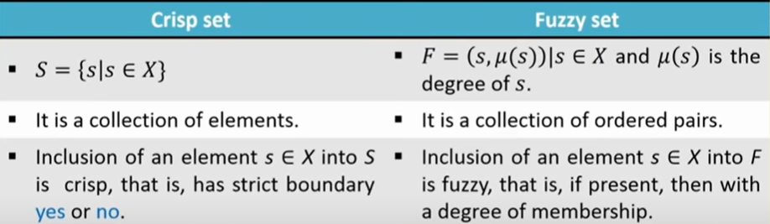
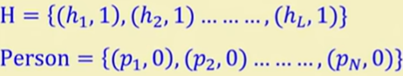
Fuzzy Set Vs Crisp Set
Note
A crisp set is a fuzzy set but a fuzzy set is not necessarily a crisp set.
Example
In case of crisp set , the elements are with extreme values of degree of membership namely either 0 or 1.

Slide 15
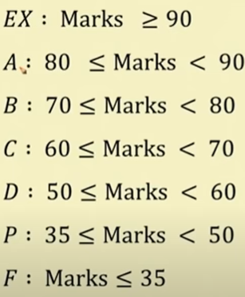
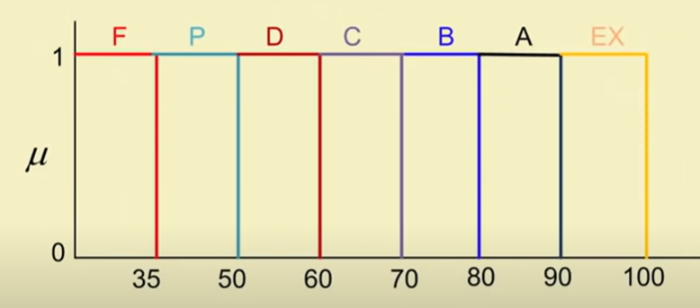
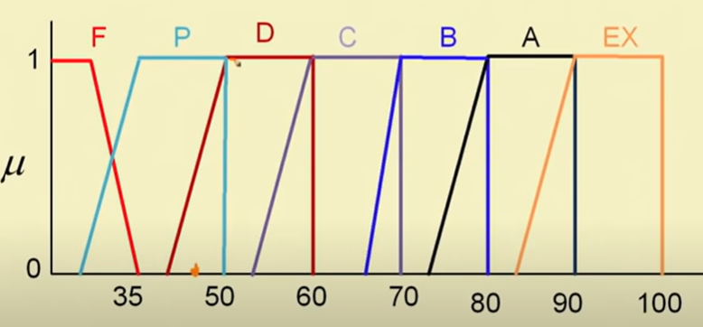
Example of Course Evaluation in crisp and fuzzy
Crisp Formulation
Fuzzy Formulation

Slide 16
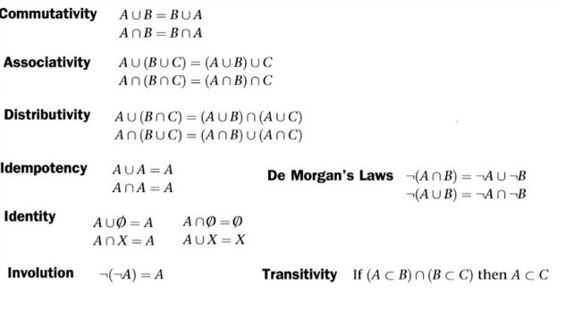
Properties of Fuzzy Sets
Law of excluded middle and Law of Contradiction doesn’t hold for Fuzzy Sets because here boundary of complement of A is ambiguous

Slide 17
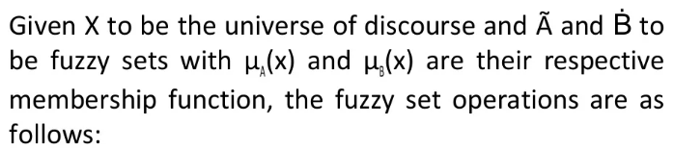
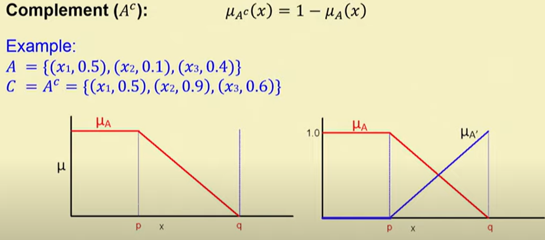
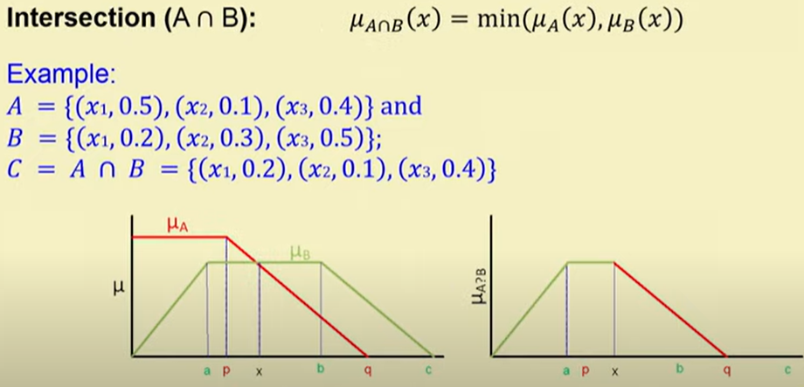
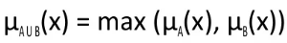
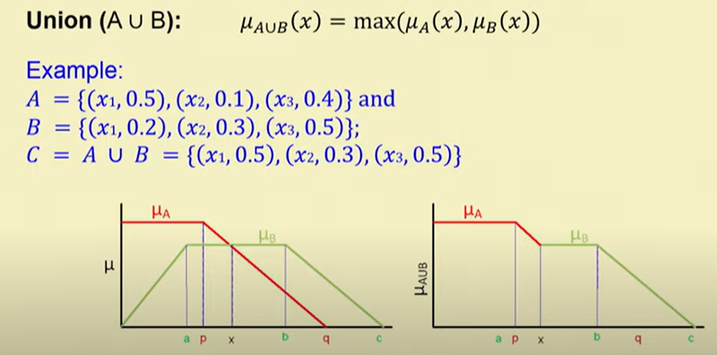
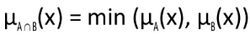
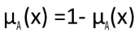
Operation on Fuzzy Set
Union
Intersection
Complement

Slide 18
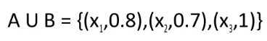
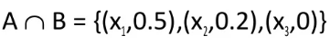
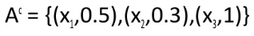
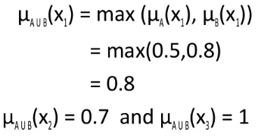
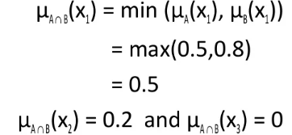
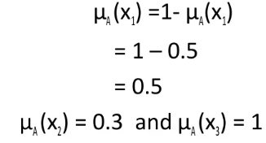
Example: Fuzzy Set Operations
Example
Union Intersection Complement

Slide 19
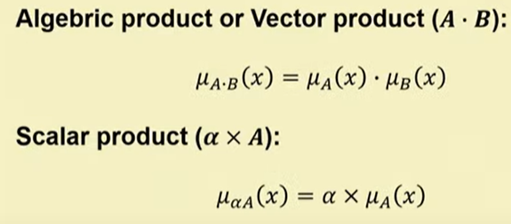
Product

Slide 20
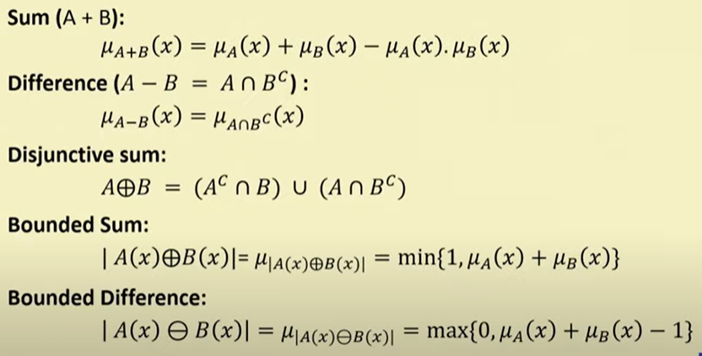
Sum and Difference

Slide 21
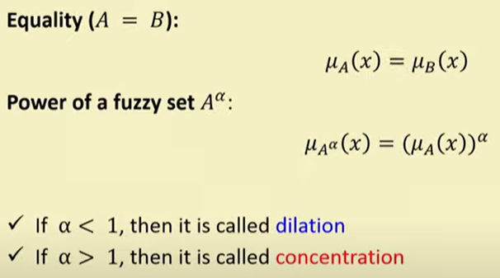
Equality and Power

Slide 22
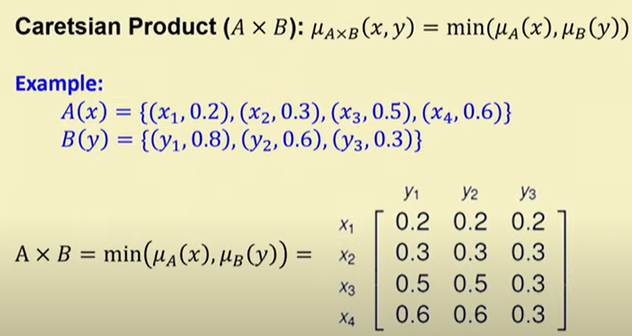
Cartesian Product

Slide 23
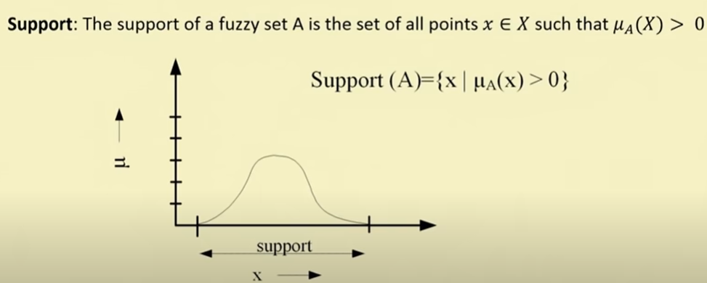
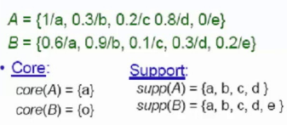
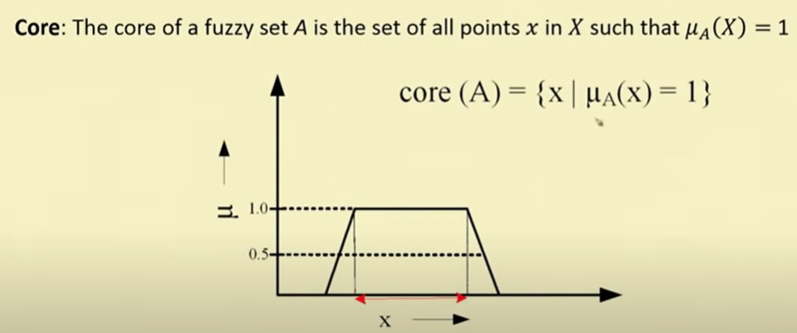
Fuzzy Set Terminologies
Support
Core
Example

Slide 24
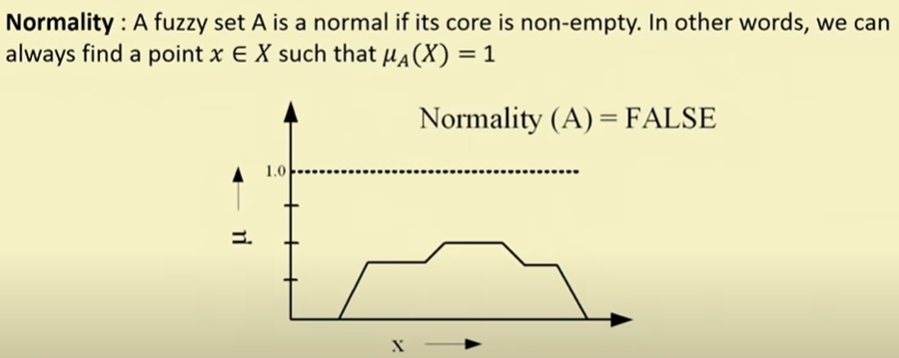
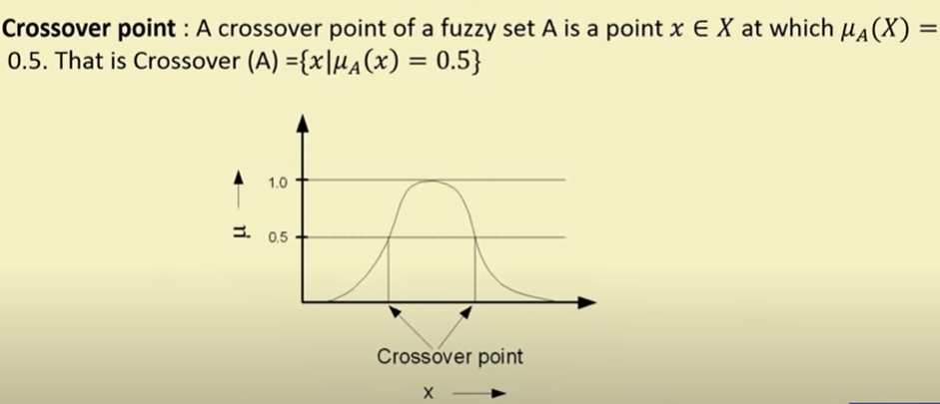
Normality
Crossover Point

Slide 25
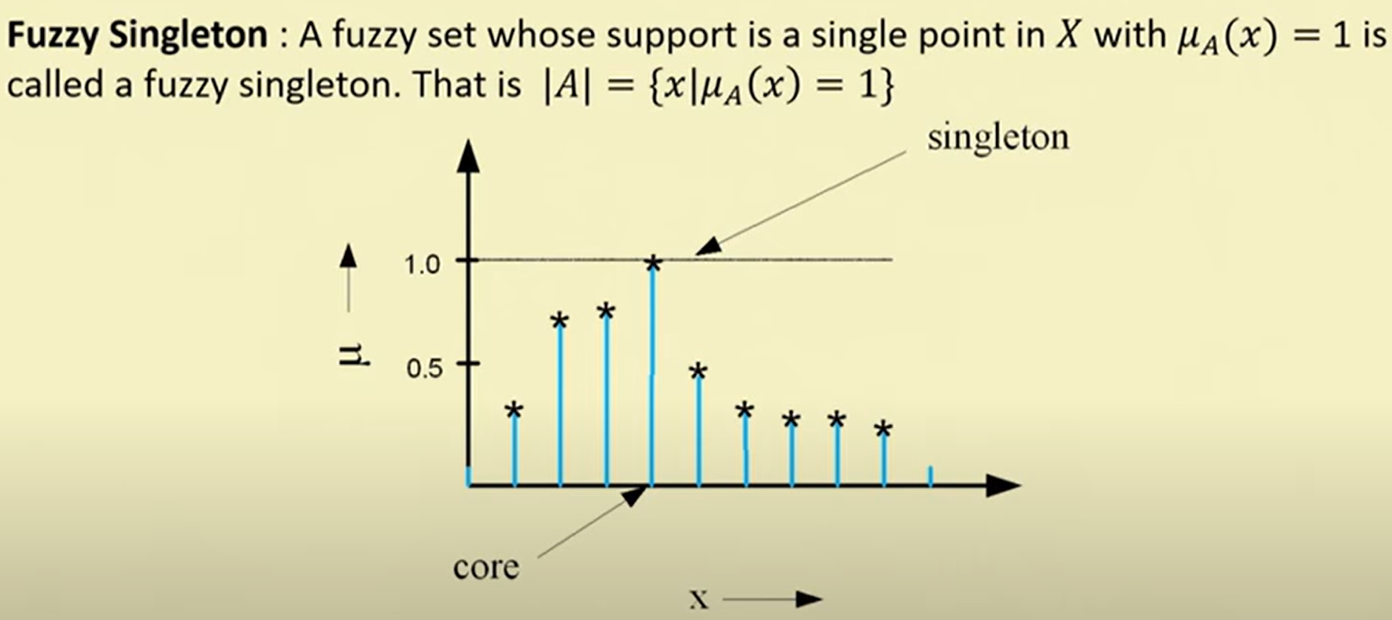
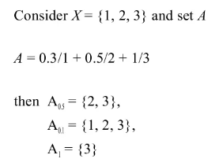
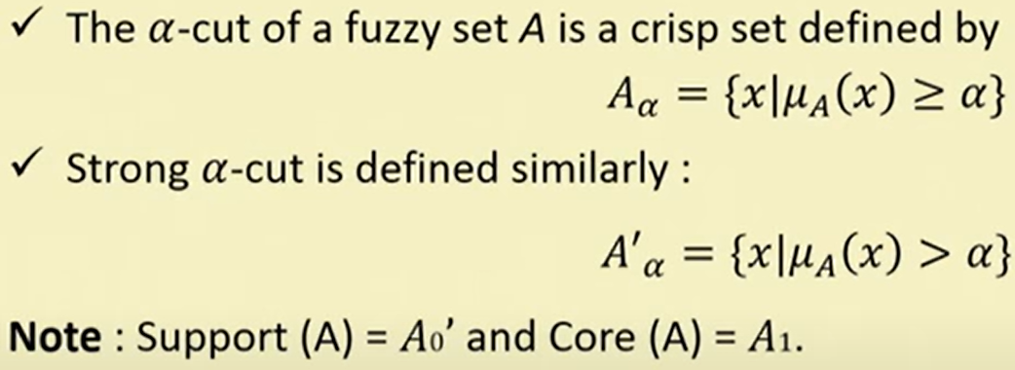
Fuzzy Singleton
Example
ɑ-cut and strong ɑ-cut:

Slide 26
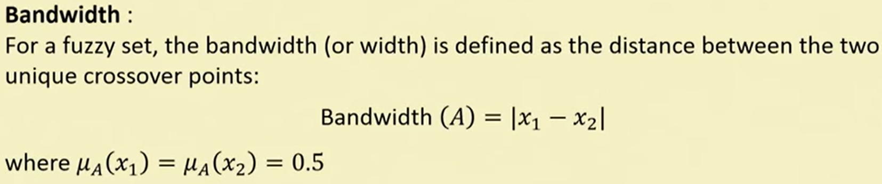
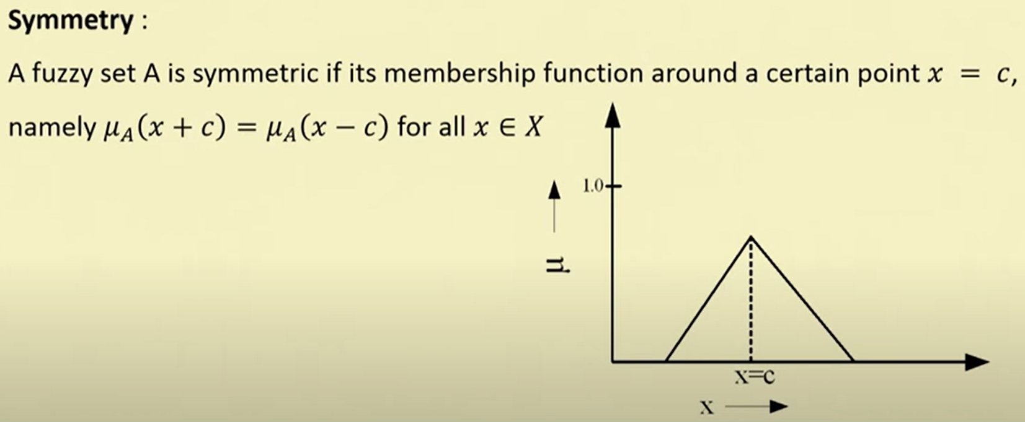
Bandwidth:
Symmetric Fuzzy Set

Slide 27
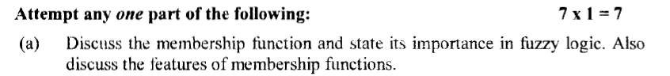
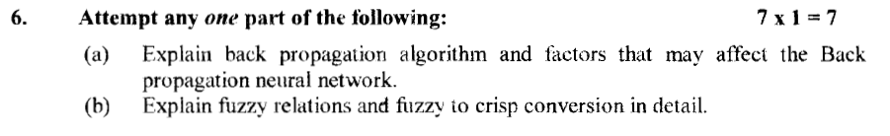
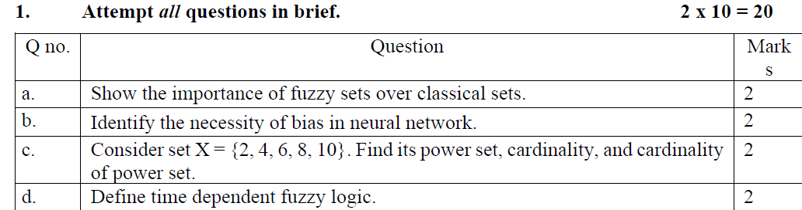
19-20,20-21

Slide 28
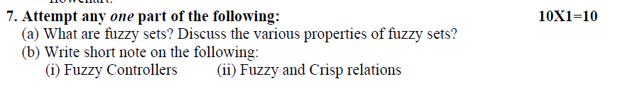


21-22,22-23

